Slide 1

Overdose Trend Comparison at Country and State Levels
Daniel Hoover
NSS DA 10
Notes:
Title Slide: This is my capstone analysis. It is a comparison of Overdose Trends between country and state level

Slide 2
Country Level Analysis
Country wide data was from the National Vital Statistic System
Their main source of data comes from death certificates submitted by each state
The data primarily reports:
The number of deaths
The drug involved
The percentage of cases where a drug could be specified (referred to as confidence)
Notes:
Country level analysis data was pulled from the National Vital Statistic System or NVSS
Most of the data from this system comes from death certificates submitted by each state
The data for overdoses primarily reports:
The number of deaths
The drug involved
Percentage of cases where a drug could be specified, which I will refer to as confidence

Slide 3
What drugs reported?
4 indicators were analyzed
Opioids
Primarily used as a pain reliever
Stimulants(or Psychostimulants)
These tend to affect the brain and spinal cord, often referred to as “uppers”
Heroin
Also an opioid, but it has been illegal to possess in the US since 1924
Cocaine
Also a stimulant, but has also been illegal in the US since 1970
Notes:
4 main indicators were analyzed.
Opioids, like hydrocodone, are used primarily as a pain reliever
Stimulants, like Amphetamines. These affect the brain and spinal cord
Heroin, another opioid, but it has been illegal to possess in the US since 1924
And cocaine, another stimulant but it has also been illegal in the US since 1970

Slide 4
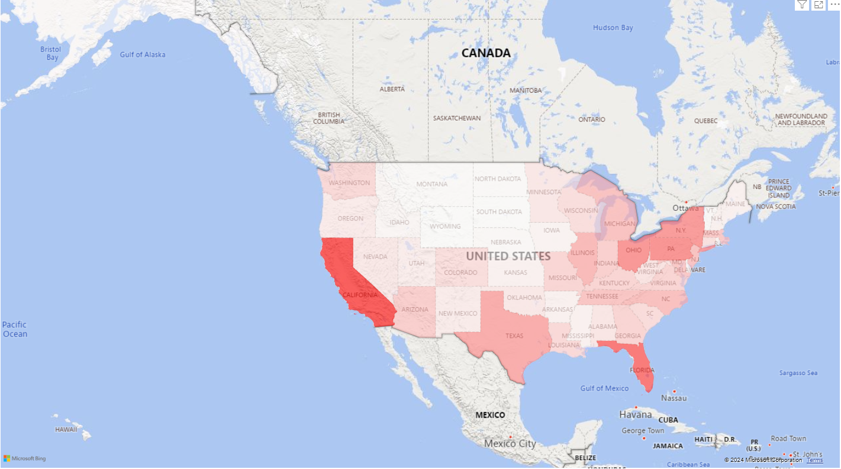
Geographic Distribution of Overdoses Across the United States
Notes:
The first question I had about this data was, how does this data look geographically? Are there certain regions of the US that had a higher count of overdose deaths than others?
Overdose deaths across the US relate very heavily to population size
Most of the states with high fatalities (Like California, Florida, Pennsylvania) also have high populations
One thing to note from this map is New York.
They have a unique circumstance.
Since New York City maintains its own legal authority, they report their mortality data separately from New York State in this data set
To make it easier to summarize, New York State and New York City numbers have been combined. But as a note, when reviewed separately, NYC tended to have high fatalities than New York State

Slide 5
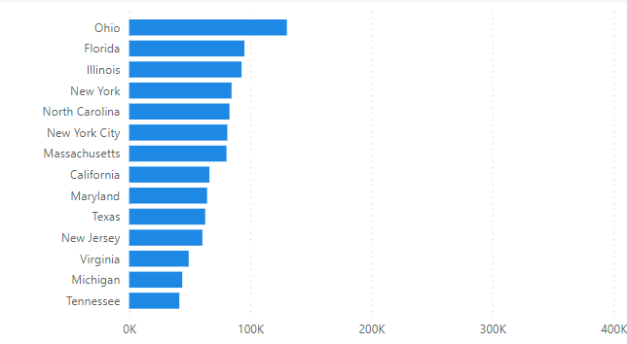
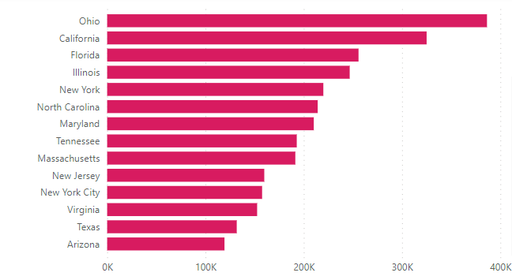
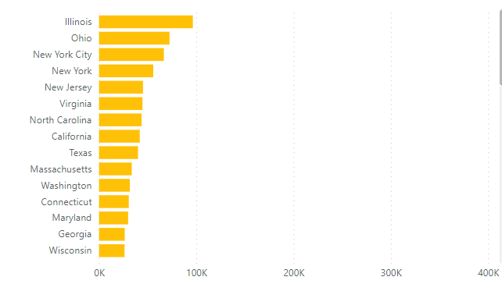
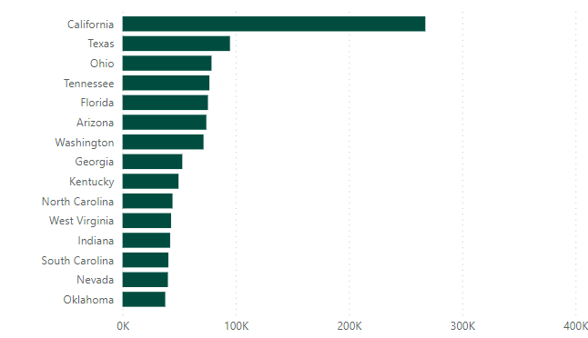
Top Drugs Involved in Overdose Deaths
Cocaine
Opioids
Heroin
Stimulants
Notes:
Knowing that all of these highly populated states suffered larger overdose rates, I wondered if the drugs involved in these overdoses were the same for these highly concentrated areas. Also, are they reporting equal drug abuse across all drugs?
The numbers of each type of drug used were once again influenced by population size. But there were some small differences.
For example, California reports very high psychostimulant abuse and report the 2nd highest for opioids. But they are reporting fewer numbers for cocaine and heroin than other, less populated states. Or another example is Illinois, which reports high numbers for cocaine, heroin, and opioids, is not even in the top 12 of states for psychostimulants.

Slide 6
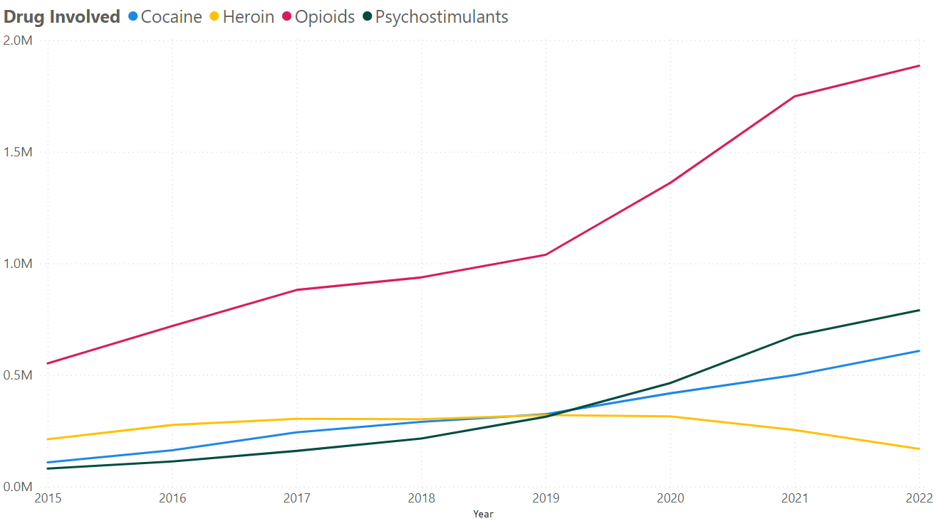
Drug Presence Over Time
Notes:
Drugs Over Time for the Country: I wanted to look at the presence of these drugs over the course of the data set to investigate as a country, are certain drugs increasing more rapidly than others over time?
In general all of the drugs are showing increased volume of overdoses, aside from heroin which has shown a decrease since 2019. Opioids shows a particularly sharp increase. Every state showed steadily increasing numbers despite population size.

Slide 7
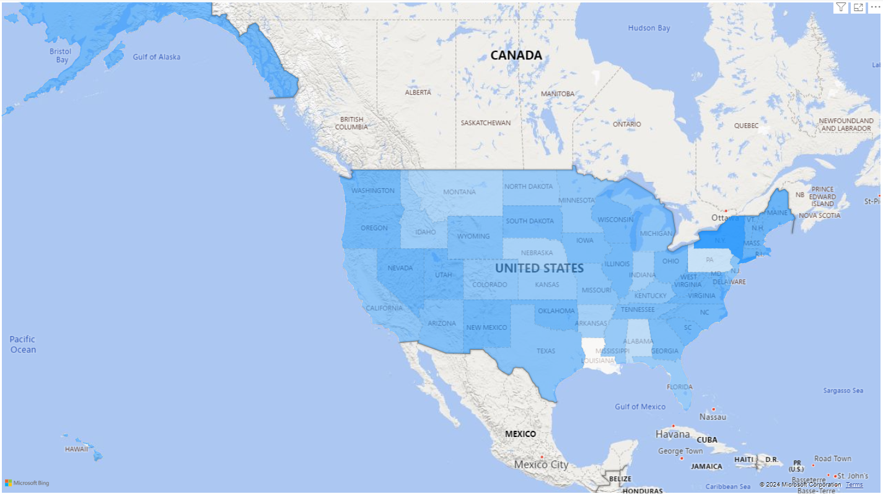
Drug Testing Confidence Across the United States
Notes:
Average Confidence Slide: How accurate are states at detecting these drugs in the event of an overdose? Within the data was an indicator showing the percent of cases where the drug leading to the overdose could be detected. As I mentioned, I referred to this as confidence since States could confidently state that a certain drug was present or not. I wondered if the average confidence in detecting these drugs would mirror that of the overdose deaths. My assumption was that a higher amount of deaths would mean more accurate detection capabilities.
I found that they did not mirror the fatality trends. Largely the Northeastern region of the US had the highest average confidence with some states, like Vermont, reporting 100% confidence for multiple years of the dataset. This leads me to another question.

Slide 8
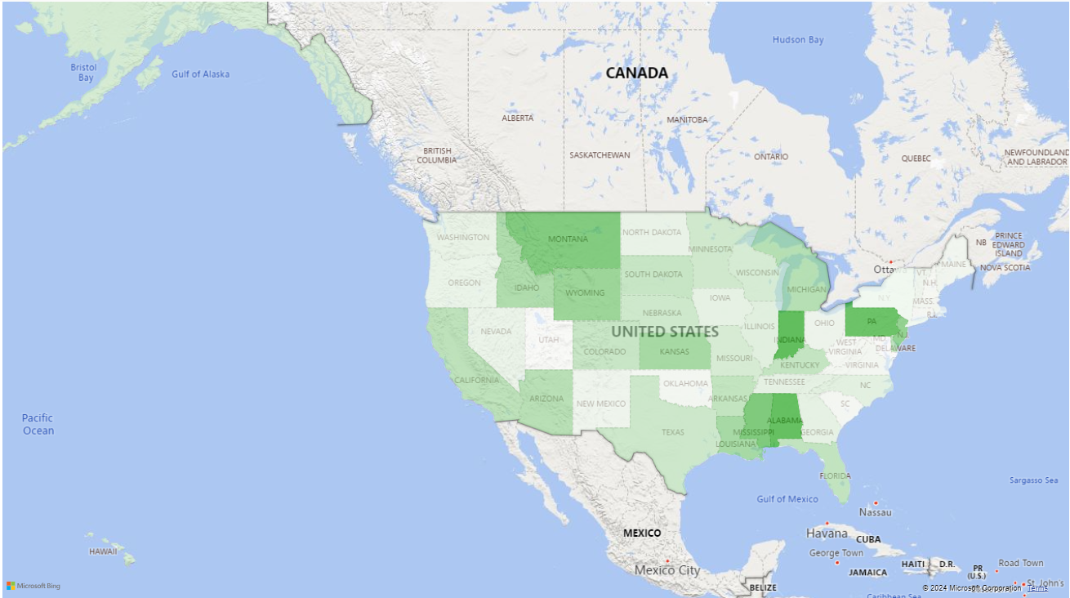
Change in Confidence Across the United States
Notes:
Change in Confidence Slide: Do states’ average confidence change over the 8 years of the data set? I would assume that as technologies advance and with overdose rates increasing, that the confidence would steadily increase country wide.
I compared the earliest available data for each state to the most recent data listed to investigate if, as a country, detection has increased.
Generally speaking, there was in fact an overall confidence improvement country wide. Some states like Indiana, Alabama, and Pennsylvania displayed the large improvements in detection capabilities. While other states only improved by a small percentage.
Five States did show a decline in confidence: New Hampshire, Rhode Island, District of Columbia, Utah, and Maryland. The decline was very small with none of these states dropping by more than 1%

Slide 9
State Level Analysis
Tennessee state data was provided from tn.gov
State data reported on many of the same categories as the NVSS, it also provided a wider variety of information to investigate
It contained 3 different data sets
Fatality data
Nonfatality data
Prescription data
Notes:
TN transition slide: Drill down to a state level to see if the trends found on the country level matched state wide. I focused on TN since that is the state I’ve lived in my whole life. Overdose fatalities, nonfatalities, and prescriptions were analyzed

Slide 10
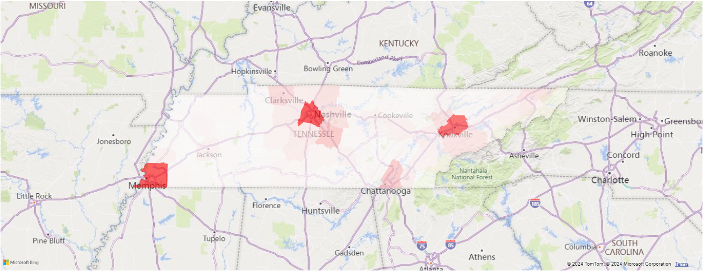
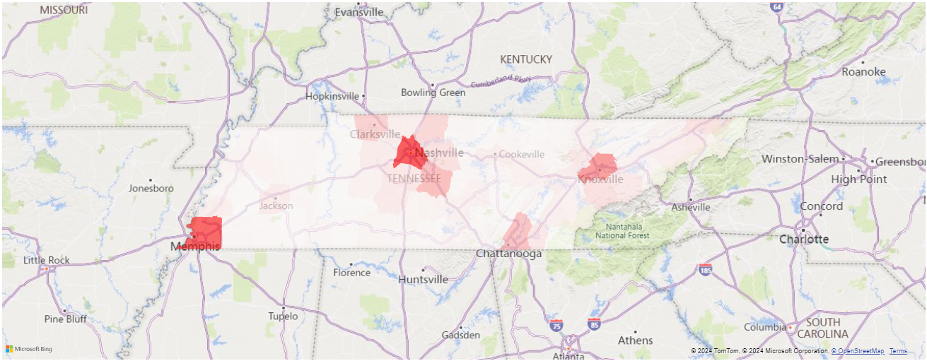
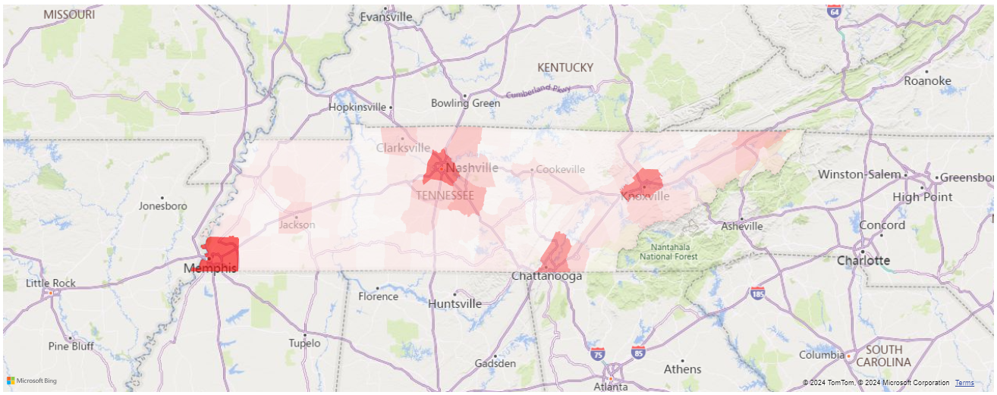
Total Fatal Overdoses by County
Geographic Distributions of Overdoses and Prescriptions on the State Level
Total Nonfatal Overdoses by County
Total Prescriptions by County
Notes:
Geographic Patterns for TN: As with the country as a whole, I wonder if within TN were there any regional patterns of overdoses.
Much like the country wide data, these overdoses are population related and there was not any significant difference across the datasets provided from the state website

Slide 11
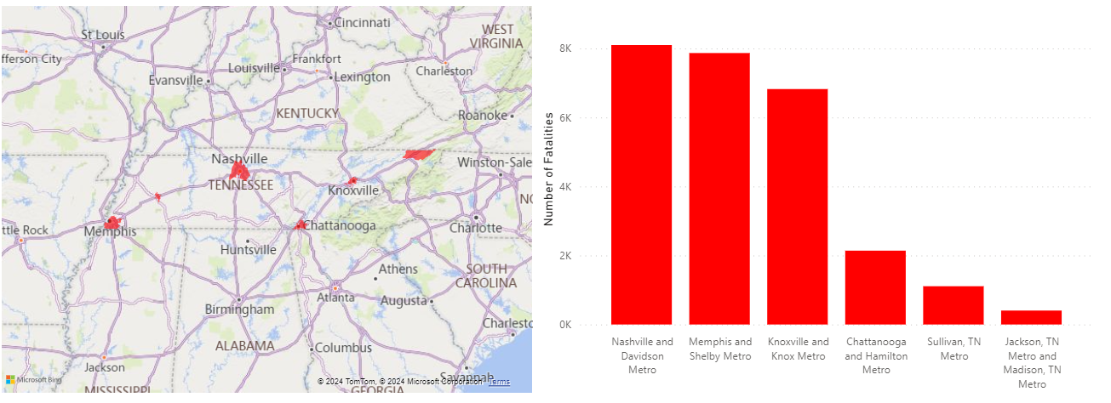
Geographic Trends of Fatal Overdoses
Notes:
Metro Number Reports:
Areas of high fatalities were areas of high populations, large cities like Nashville and Memphis showed the highest amount of overdoses. As population of metro areas decreased, so did the rate of overdose deaths.
This also reflects what was seen with New York where New York City reported higher numbers than the state at large. Metro areas in Tennessee tended to report higher numbers, though by a smaller margin than the New York example.

Slide 12
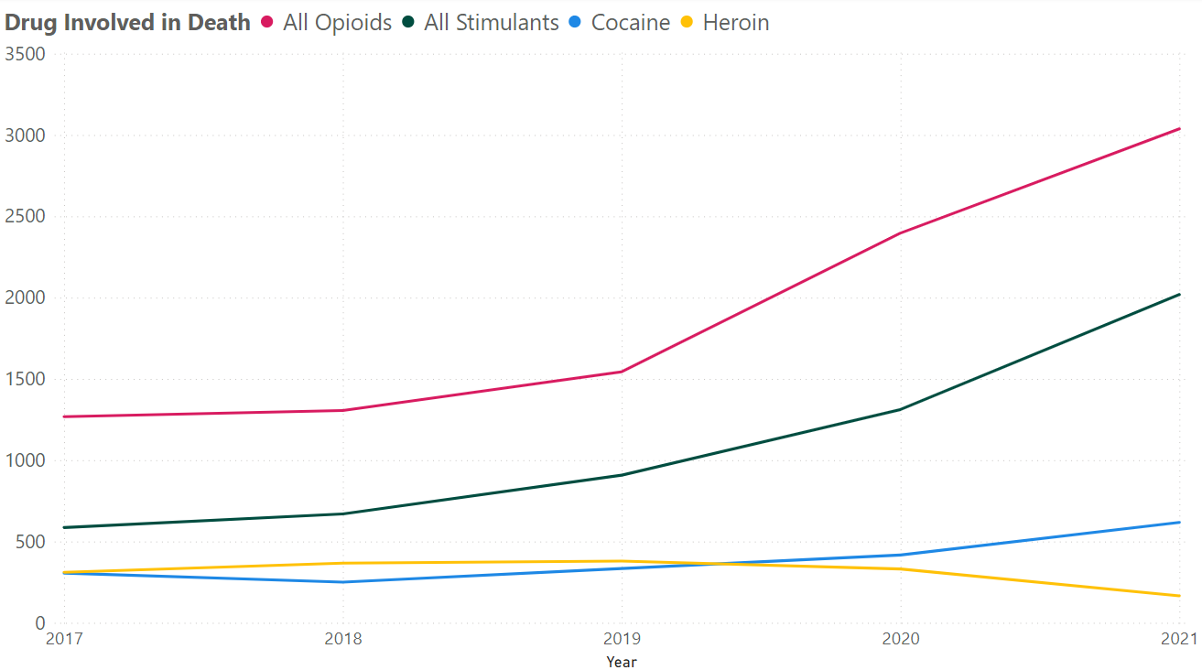
Drug Occurrence in Fatalities Over Time
Country
Tennessee
Notes:
Drug Occurrence in Fatalities: So how did Tennessee as a state compare to the country as a whole?
The trends seen at the country level are very similar as what is seen at a state level. The high opioid presence as well as the beginnings of a decline in heroin abuse around 2019.
There is a difference noted in the representation of stimulants within Tennessee overdoses that is not so reflected in the Country wide data.
--Note the different scales on the graphs. I was looking more at trends here, obviously the scales vary since the United States has a larger population than just Tennessee

Slide 13
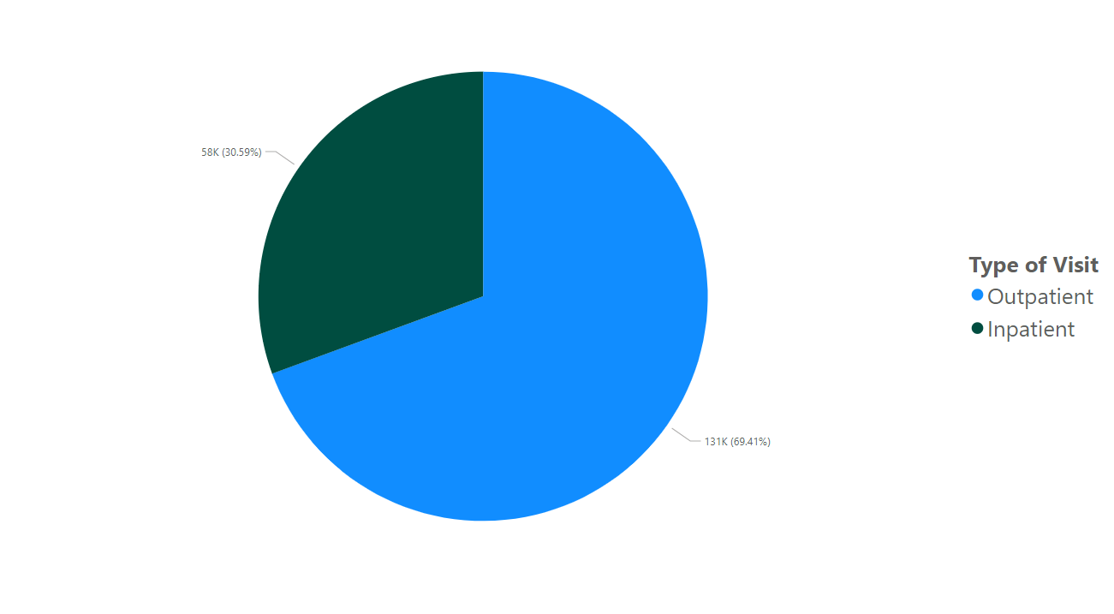
Nonfatal Overdose Patient Care
Notes:
Nonfatal Overdose Care: Investigating nonfatal cases of overdoses really interested me. I usually assumed that overdoses always lead to death. But that is not the case. In some cases, the person makes it to a medical facility and is successfully treated. How are these patients treated?
Over half of the nonfatalities treated were outpatient procedures.
Inpatient showed much lower numbers. This indicates that while overdosing is a very serious problem, if one can make it to a medical facility, there are quick solutions that prevent the need for long hospital stays in most cases.

Slide 14
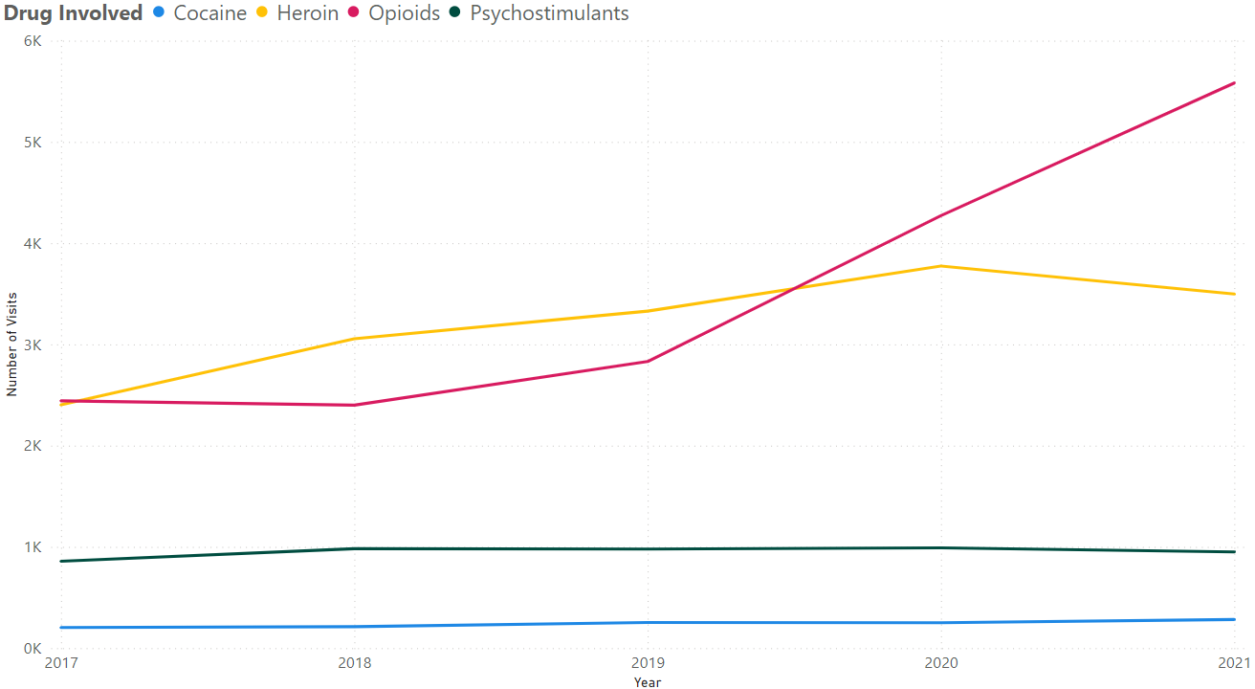
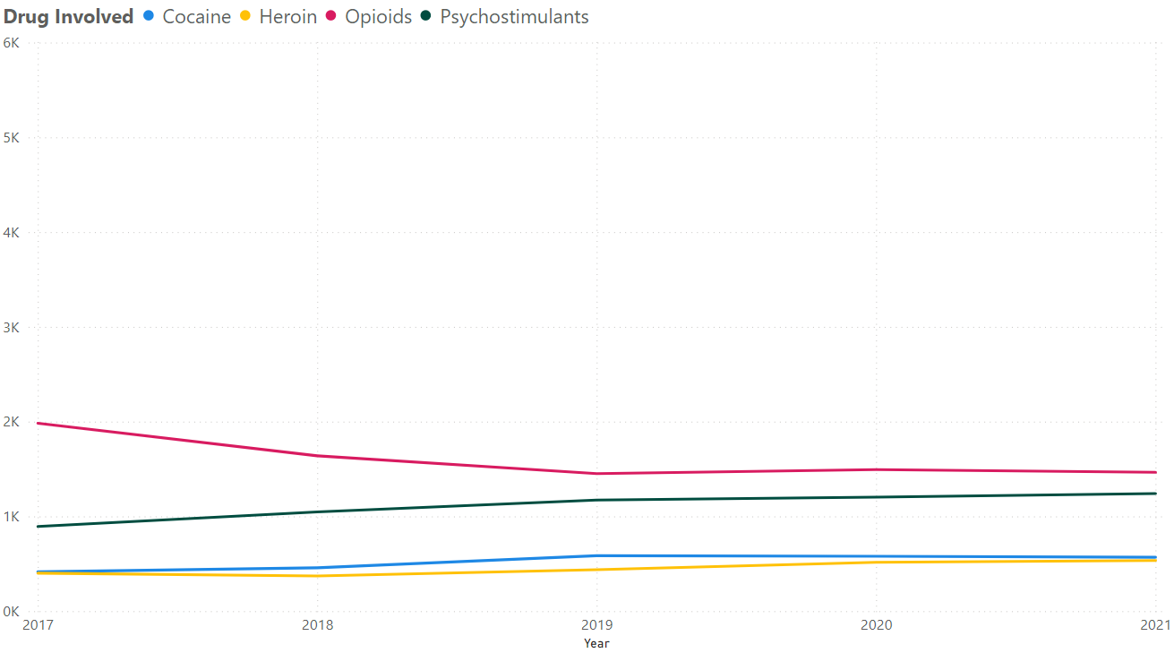
Nonfatal Outpatient Drug Occurrence Over Time
Nonfatal Inpatient Drug Occurrence Over Time
Notes:
Outpatient Drug Occurrence Over Time: In outpatient cases are certain drugs involved more often than others? Do the trends seen in nonfatalities mirror those seen in fatalities
Like the country wide data, opioids have been increasingly more involved in overdoses as time has progressed. Also similarly to country wide data, heroin has been on a decline since around 2020. However the number of nonfatal cases of heroin abuse is higher than fatal cases.
All other classes of drugs remained at fairly low and consistent numbers
Inpatient Drug Occurrence: These trends differ from outpatient. With smaller counts of both opioid and heroin abuse compared to outpatient cases.

Slide 15
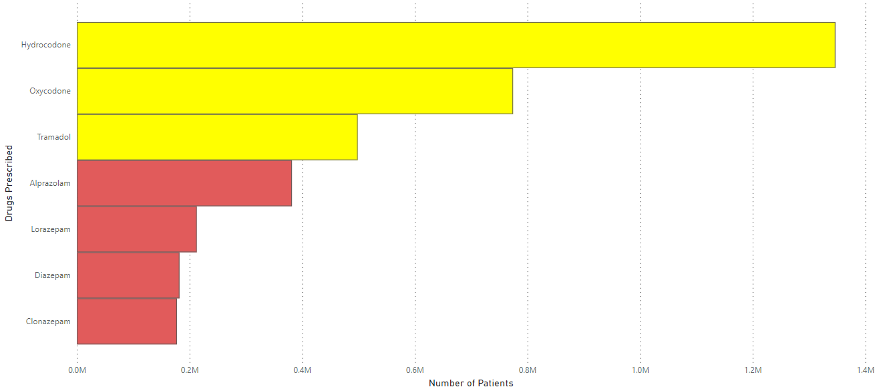
Drugs Prescribed Across Tennessee
Notes:
Are certain classes of drugs prescribed more often?
Tennessee government tracked these 7 drugs specifically cause of their high potential for abuse
This graph shows the number of patients prescribed these drugs with potential for abuse.
They are color coded base on what type of drug they are. Yellow colored drugs are opioids and the red colored drugs are benzodiazepines.
Considering that this is only patients and not counts of the drug itself, It is worth noting that this doesn’t represent the presence of the drug with the community but more shows the number of people with access to these different drugs. Its also important to note that the size of each prescription is also not represented.
Since there isn’t a for sure count of how many doses each patient gets, I feel this strongly implies that the increase in opioid abuse we have seen on state level and country level is likely due to availability.

Slide 16
Limitations
When reviewing the data from NVSS, one limitation was found in circumstances where more than one drug was involved, an overdose might have been counted for each drug present
This data can vary from the NVSS since it incorporates data from many different sources:
Hospital supplied data
Medical Examiner reports
Law Enforcement data
This might contribute to inaccuracies across these institutions if reporting standards vary
Notes:
With NVSS reporting, if more than one drug was found, the overdose was reported for each drug detected.
States can pull their data from multiple sources:Hospitals, Medical Examiners, Law enforcement.
Any discrepancies in state data might stem from different reporting techniques from the different sources.

Slide 17
Conclusions
How do overdose trends across the country compare to trends seen only within Tennessee?
Trends seen on the state level mirror those observed at a country level, geographically and in terms of drugs abused
Fatalities tend to happen in areas with a high population
Of the types of drugs observed, opioids are the most likely to be involved in overdose across most states
This is most likely due to availability
90% of states have shown an increased confidence in testing for drugs
Nonfatal overdoses are more often treated through outpatient procedures
Tennessee displays a higher amount of abuse than the country as a whole
Notes:
How do overdose trends across the country compare to trends seen only within Tennessee?
-Trends seen on the state level mirror those observed at a country level, geographically and in terms of drugs abused
-Fatalities tend to happen in areas with a high population
Of the types of drugs observed, opioids are the most likely to be involved in overdose across most states
-This is most likely due to availability
What I am calling my bonus findings, since I wasn’t expecting to find them but dove a little deeper on them when I did:
-90% of states have shown an increased confidence in testing for drugs
-Most of nonfatal overdoses that are treated are out patient procedures
-Tennessee has displays a higher amount of stimulant abuse than the country as a whole

